Slide 1
TO CREATE A WEB PAGE FOR MOVIE TICKET TRNSFER (ISM)
Department:- Btech-4th year, CSE-D
B Sharath Reddy (19E41A05K4)
AC Adarsh (19E41A05M0)
CH karthik (19E41A05G2)
Y Akshith (19E41A05H9)

Slide 2
INTRODUCTION:-
Movie Ticket Transfer (ISM), it is the ideology about the movie tickets selling in the website are already purchased from the Bookmyshow, the main intension of this project is not to waste money as well as tickets.
And those tickets will be available in the website which is developed free of cost and always available for users(user friendly).
The tickets which are booked in the Bookmyshow by any person, and if he is not able to attend the show due to any problem and if he wants to cancel the show tickets, then our website will always available at that situations at free of cost.

Slide 3
Here the owner who wanted to sell tickets, he may sell on our platform to customers who are looking for tickets on our website.
In our webpage not only movie tickets, such as event tickets, cricket match tickets also available etc..
The main thing is that we’re not going to sell tickets by increasing their original price. We keep tickets available at discounted prices. Here on our platform tickets are available in (5%) five percent less than the original price.

Slide 4



PROJECT’S OBJECTIVE:-
The main objective of this project is to sell the tickets in the website which is user friendly environment of users and owners.
ISM (Website)
movie tickets
Events tickets
Cricket match tickets etc..
Owner
Customer

Slide 5

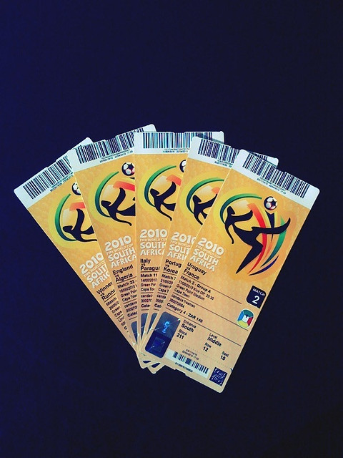


REASON FOR THE PROJECT:-
The main reason behind this project is not to waste money and the tickets. The Owner will receive the money and the Customer will receive the tickets.
As well as both are satisfied.
owner
customer
There are satisfied

Slide 6
SOFTWARE AND HARDWARE REQUIRMENTS:-
HARDWARE REQUIREMENTS:
System : Intel i3 or Above
Hard Disk : 100 GB or Above
Internet : 2Mbps or Above
Ram : 4GB or Above
SOFTWARE REQUIREMENTS:
Operating system : Windows 10
programming Language : Python
Front-End : Html ,CSS
Designing : Html, Css, java script
Data Base : SQLite3
Execution tool : Pycharm

Slide 7


